Slide 1
The sum of the infinite and finite geometric sequence

Slide 2
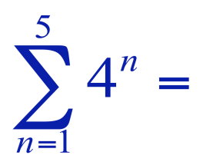
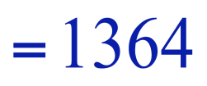
The sum of the first n terms of a sequence is represented by summation notation.
upper limit of summation
index of summation
lower limit of summation
2

Slide 3
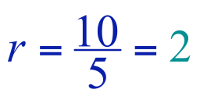
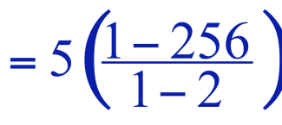
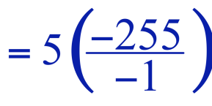
The sum of a finite geometric sequence is given by
5 + 10 + 20 + 40 + 80 + 160 + 320 + 640 = ?
n = 8
a₁ = 5

Slide 4
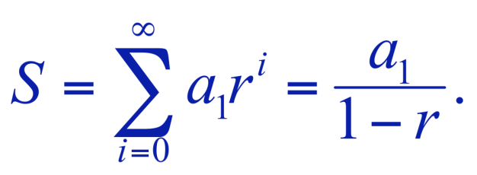
The sum of the terms of an infinite geometric sequence is called a geometric series.
If |r| < 1, then the infinite geometric series
a₁ + a₁r + a₁r² + a₁r³ + . . . + a₁r^{n-1} + . . .
has the sum

Slide 5
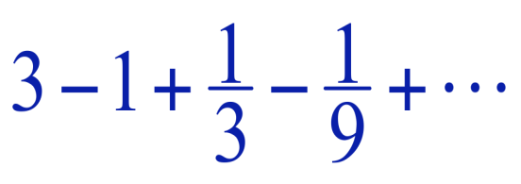
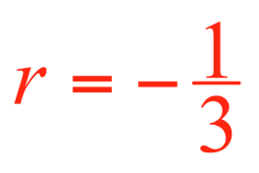
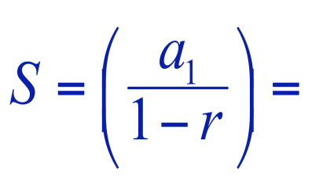
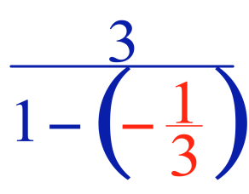
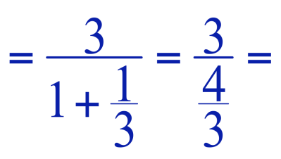
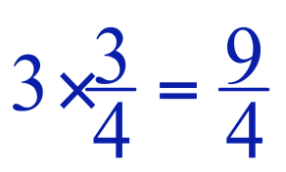
Example: Find the sum of
The sum of the series is

Slide 6
Convergent and Divergent Series

Slide 7
Convergent and Divergent Series
If the infinite series has a sum, or limit, the series is convergent.
If the series is not convergent, it is divergent.

Slide 8
Ways To Determine Convergence/Divergence
1. Arithmetic – since no sum exists, it diverges
2. Geometric:
If |r| > 1, diverges
If |r| < 1, converges since the sum exists
3. Ratio Test (discussed in a few minutes)

Slide 9
Example
Determine whether each arithmetic or geometric series is convergent or divergent.
1/8 + 3/20 + 9/50 + 27/125 + . . .
r=6/5 → |r|>1 → divergent
18.75+17.50+16.25+15.00+ . . .
Arithmetic series → divergent
65 + 13 + 2 3/5 + 13/25 . . .
r=1/5 → |r|<1 → convergent

Slide 10
Other Series
When a series is neither arithmetic or geometric, it is more difficult to determine whether the series is convergent or divergent.

